Slide 1
Communications Subcommittee
Michael Hyde
Northern Neck Electric Cooperative

Slide 2
TWACS Customer Portal
The TWACS Customer Portal (http://customer.aclaratech.com) provides a wide range of information that can serve as a starting point when you have a question. The Portal contains information such as:
User Guides
Customer Discussion Threads
Training Registration
Software Downloads
Certified Partner Information
Aclara Client Conference Information
News & Upcoming Events
Aclara Newsletter

Slide 3
Plans From 2010
Documentation
Conference Materials
Shipment Tracking
Software Patches & Updates
New Trouble Ticketing System

Slide 4

Plans From 2010
Documentation
Conference Materials
Shipment Tracking
Software Patches & Updates
New Trouble Ticketing System
Notes:
More Documentation has been added.
Begun breaking up and indexing documents for better searching and linking.

Slide 5
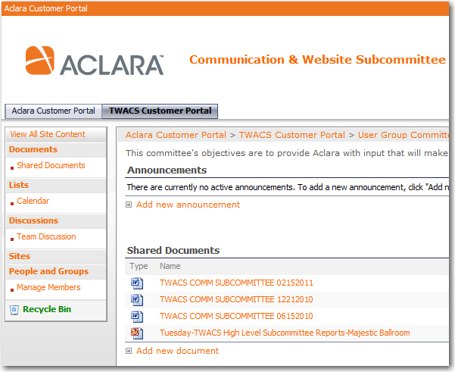
Subcommittee Documentation
Meeting Minutes
Handouts
Reference

Slide 6
Plans From 2010
Documentation
Conference Materials
Shipment Tracking
Software Patches & Updates
New Trouble Ticketing System
Notes:
Presentations from these conferences
Client only session updates

Slide 7
Plans From 2010
Documentation
Conference Materials
Shipment Tracking
Software Patches & Updates
New Trouble Ticketing System

Slide 8
Plans From 2010
Documentation
Conference Materials
Shipment Tracking
Software Patches & Updates
New Trouble Ticketing System

Slide 9
Plans From 2010
Documentation
Conference Materials
Shipment Tracking
Software Patches & Updates
New Trouble Ticketing System

Slide 10
Portal Site Statistics
Notes:
Raise your hand if you have used the portal
Raise your hand if you do not have an account on the portal
Raise the hand if you have found the portal useful
Why are you not using the portal?
Is there something you would like to see on the portal?

Slide 11
Daily Usage Statistics

Slide 12
Plans For 2011
More Searchable Documentation
Software Patches & Updates
Implementation of new ticket system
Future of Subcommittee?
Notes:
More software updates and patches
Aclara is working on a new ticket system, which may be combining all the Aclara brands. Please provide any input to care@aclara.com.
Subcommittee will return for 2011, please volunteer.

